Slide 1
Automated Detection of Kidney Cysts, Stones, and Tumors in CT Radiography using Deep Learning and CT Images
202112096 Valiev Koyiljon

Slide 2

Background
Kidney Disease Burden: According to the National Kidney Foundation, approximately 10% of the global population is affected by chronic kidney disease (CKD) due to lifestyle disorders [1].
Challenges: Late diagnosis due to expert scarcity.

Slide 3
Early Screening
Computed tomography (CT) scans reliably reveal abnormalities but manual review processes are time-consuming and susceptible to interpretational errors
Opportunity for AI to widen access and more efficient analysis
Promise of deep learning approaches

Slide 4
Our Goal
Develop a precise model for detecting and categorizing kidney abnormalities into four distinct classes: Kidney Cysts, Stones, Tumors and Normal

Slide 5
Literature Review
Existing Studies: Previous research efforts have employed deep learning techniques for the detection and classification of various renal pathologies from medical images.
Outcomes from Studies: Noteworthy outcomes include automated cyst and stone detection using different algorithms and models with varying accuracies.
Research Gap: The scarcity of comprehensive diagnostics covering multiple kidney diseases concurrently, highlighting the need for advancements in this domain.

Slide 6
Methodology - Dataset Description
Dataset Insight: The dataset, comprising 12,446 CT scans, meticulously annotated by healthcare specialists, represents a diverse range of kidney conditions: cysts, stones, tumors, and normal kidney structures.
Training Preparation: Extensive pre-processing steps were taken, including resizing, augmenting through clockwise rotation, and balancing the dataset. These measures aimed to ensure an equal representation of different pathology classes, enhancing the effectiveness of model training.

Slide 7
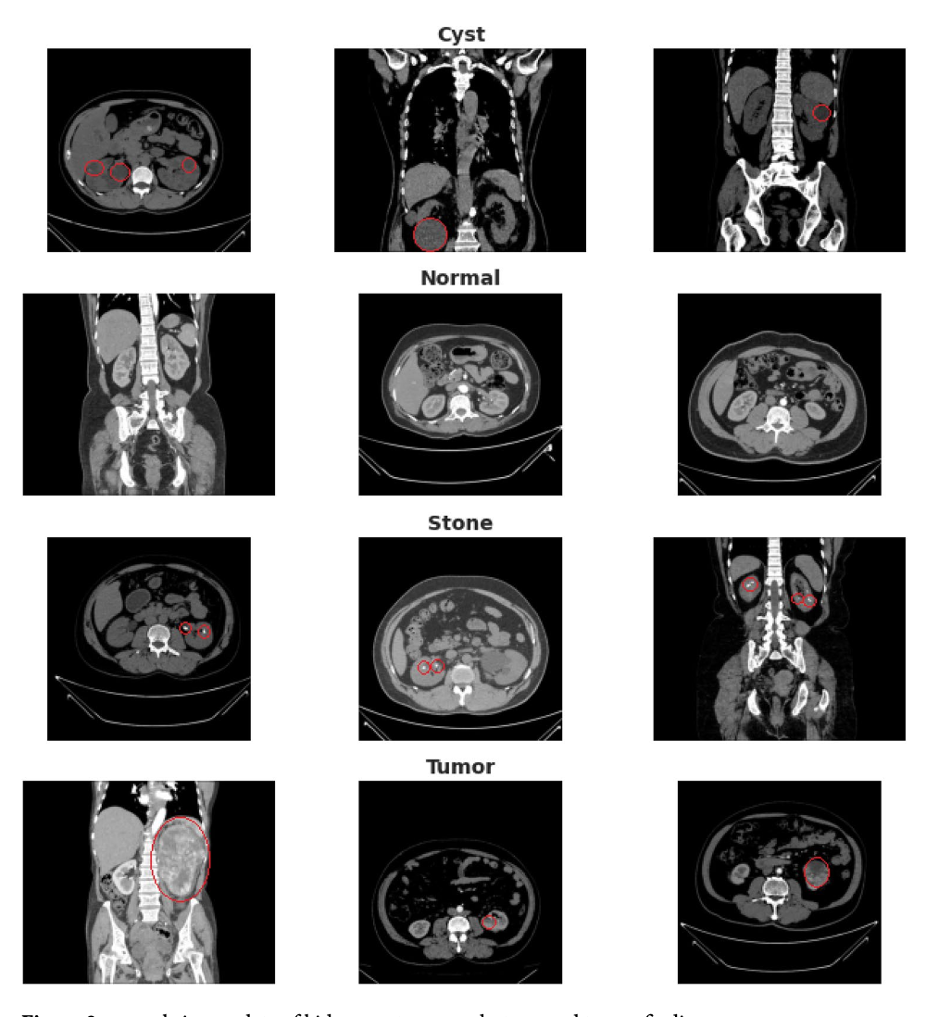
Dataset Example
Source: CT KIDNEY DATASET: Normal-Cyst-Tumor and Stone (kaggle.com)

Slide 8
Methodology - Image Processing
Image Processing Steps: The initial phase included resizing, and normalization, adapting images to suit different neural network architectures' requirements.
Example, Images for ResNet50, VGG16, and VGG19 models were adjusted to dimensions of 299 by 299 pixels, while those for U-Net were resized to 128 by 128 pixels, aligning with the unique needs of each model.
Balanced Representation: A specific selection of 1,320 images per diagnosis class such as cyst, stone, tumor, normal aimed to maintain equal class representation, crucial for unbiased model training

Slide 9
Methodology - Model Customization
Model Customization Details: Modifications and adaptations were made to popular deep learning architectures - VGG16, ResNet50, VGG19, and UNet - optimizing their parameters differentiate the 4 kidney disease classes from image.
Parameter Adjustment: Adjustments included fine-tuning parameters and architectural changes tailored for kidney abnormality identification.

Slide 10
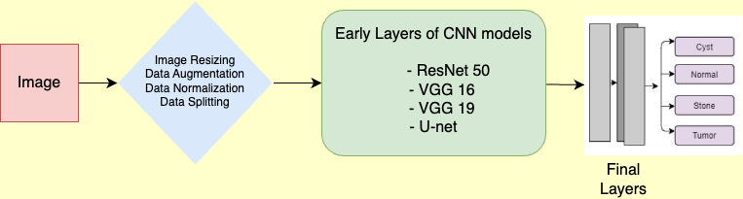
Model Flow Chart
Dataset
Data preprocessing
Initial layers
Source: Figure 1 | Scientific Reports (nature.com)

Slide 11
U-net Model Flow and Layer Details
Layer Details
U-Net Adaptation: We adapted the U-Net, originally for segmentation, to classify kidney problems.
Encoder Blocks: These initial layers capture essential features from CT images.
Decoder Blocks: Following layers help interpret features and make predictions.
Skip Connections: Intermediate links preserve vital details for better accuracy.
Output Layer: Final predictions categorize kidney issues based on learned features

Slide 12
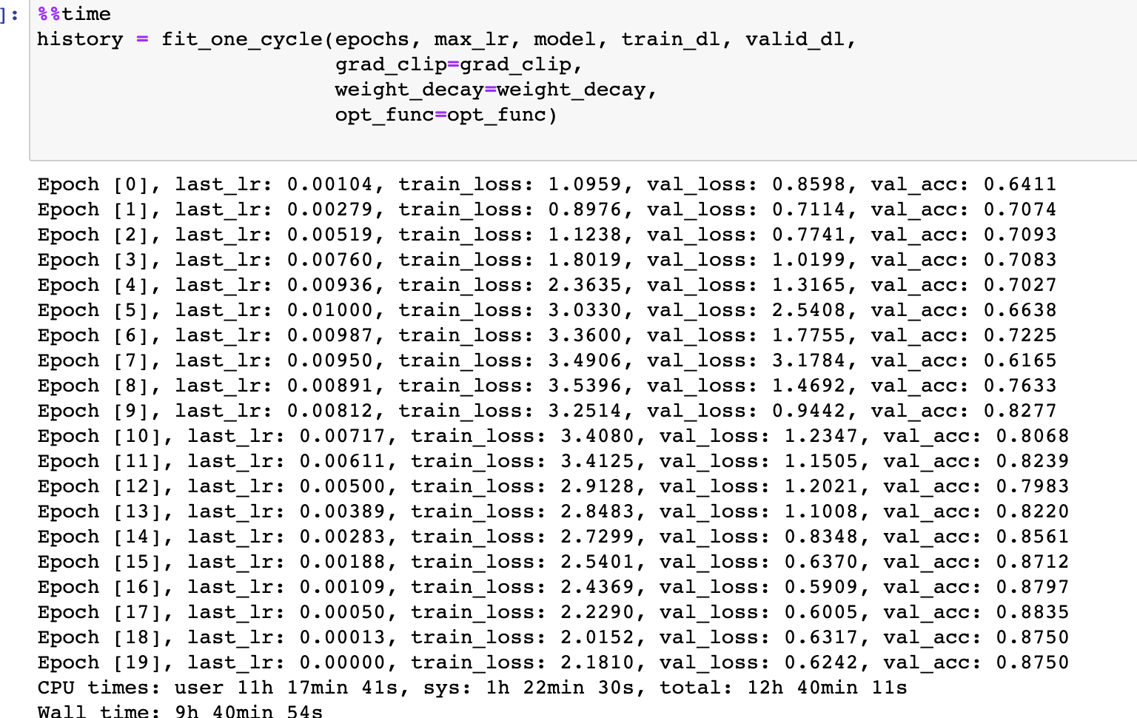
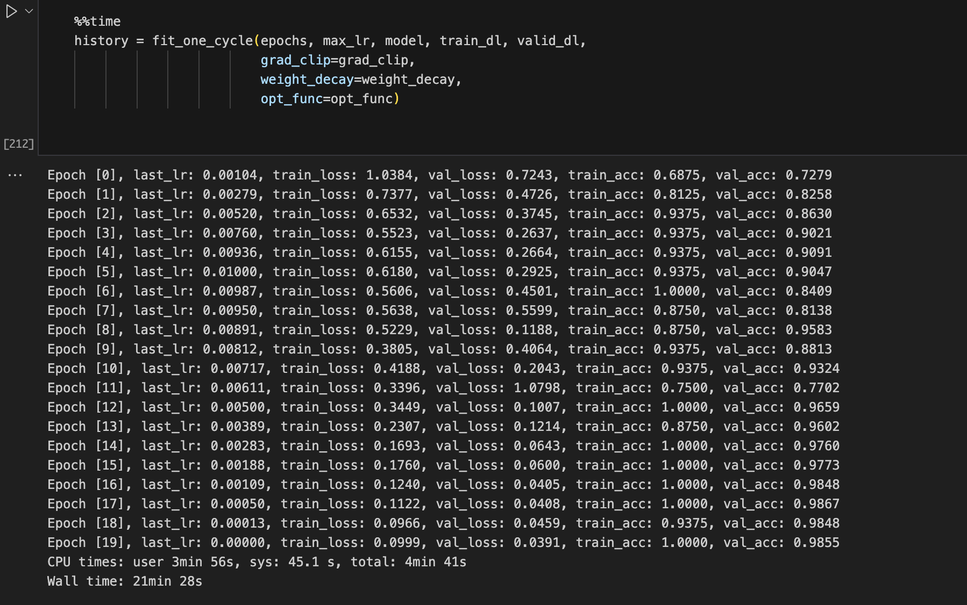
Training Process
Training Step
Macbook M1 and Google Colab’s free GPUs accelerated deep model optimization.
Tuned models up to 50 epochs with 16 CT scan batch size.

Slide 13
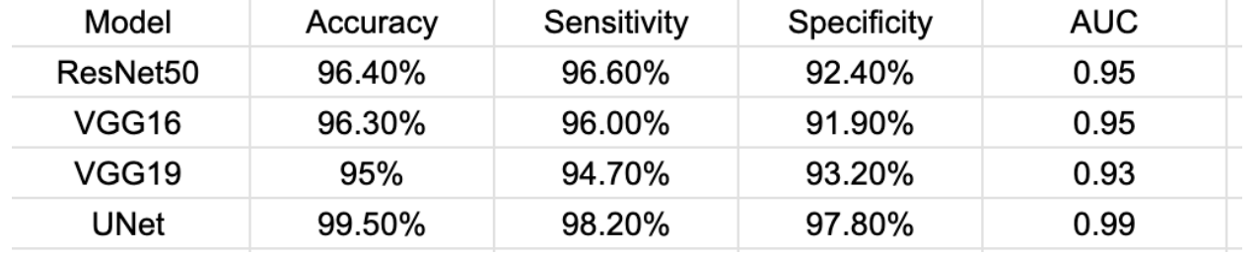
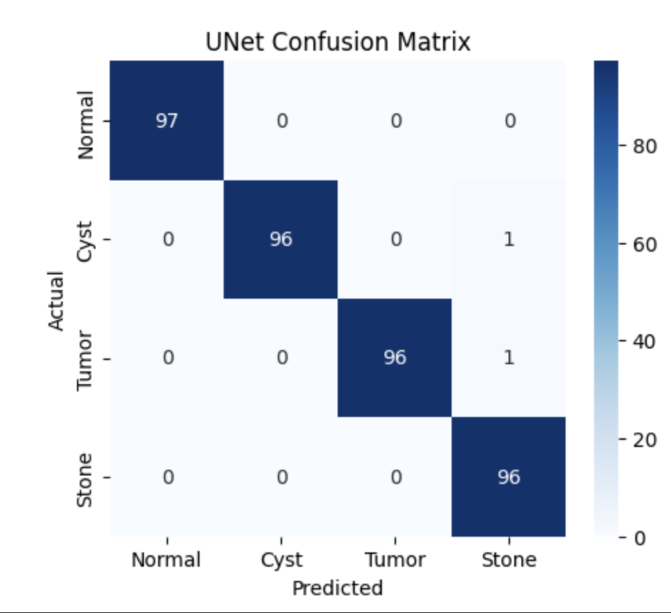
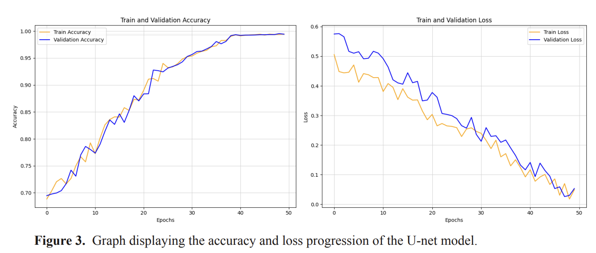
Evaluation Metrics
U-Net attained the best accuracy at 99.5%, significantly higher than the other CNN models.

Slide 14
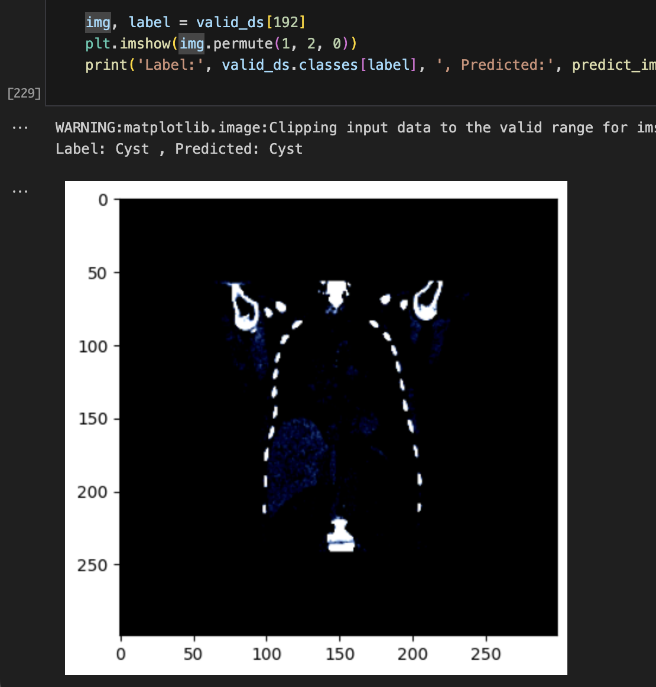
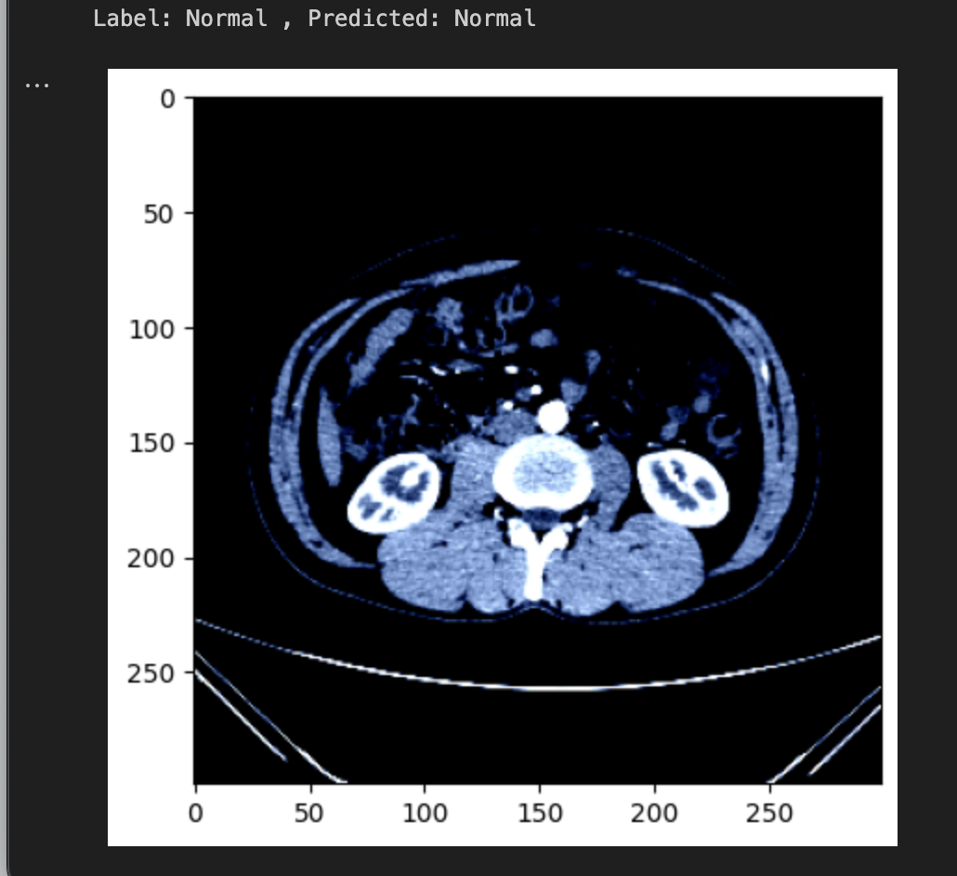
Testing with Individual Images

Slide 15
Contributions
Advanced Diagnostic Precision: Leveraging deep learning for accurate detection of kidney cysts, stones, and tumors in CT-Radiography.
Efficiency in Diagnosis: Streamlining the process by incorporating efficient deep learning techniques, aiding faster identification of critical renal conditions.
Clinical Impact: Potential for timely intervention, improved patient outcomes, and future advancements in AI-driven healthcare solutions.

Slide 16


Slide 17
Reference
1. Sanmarchi, F., Fanconi, C., Golinelli, D., Gori, D., Hernandez-Boussard, T., & Capodici, A. (2023). Predict, diagnose, and treat chronic kidney disease with machine learning: a systematic literature review. Journal of Nephrology, 36(1), 1101-11171.

